Slide 1


Customer Insight Tracking
Kick-off meeting
-By Pharbers Technology
2017 June

Slide 2
Content
Project Background
Project Objective and Approach
Timeline

Slide 3
Growth rate for oral anti-fungal market is over 15%. Sporanox keeps its leading position though it is slowing losing share in this fragmented market
Market Landscape of Oral Anti-fungal Market
(Sales Value, Bn RMB)
1,23
+16%
VFEND PFZ
1,02
29%
SPORANOX XJS
0,95
26%
VORICONAZOLE CDU
0,77
24%
VORICONAZOLE S4+
0,69
17%
19%
19%
DIFLUCAN PZD
17%
22%
12%
DING KE SDQ
25%
25%
9%
11%
7%
5%
6%
8%
BEI JIA H3B
1%
7%
5%
7%
3%
6%
7%
7%
Others
6%
4%
6%
6%
3%
5%
6%
4%
3%
33%
30%
26%
22%
19%
2011
2012
2013
2014
2015
Data Source: IMS CHPA

Slide 4
An EDA survey tool is equipped to field force in 2016 to optimize detailing strategy with expectation to drive sales
Detailing Strategy
Prescription behavior
Treatment preference
Brand perception
Detailing preference
Physician’s perception on disease, treatment, and usage is regularly collected from EDA survey tool to guide detailing strategy
A regular report to track client’s prescription behavior and attitude towards Sporanox is needed in order to derive actionable insights for detailing strategy

Slide 5
Content
Project Background
Project Objective and Approach
Timeline

Slide 6
Data mining and descriptive data analysis are conducted for tracking report development
Objectives
Develop regular analysis report to track client’s perception progression. Generate actionable insights to drive detailing strategy
Project
kick-off
Survey data descriptive analysis
Descriptive analysis on additional data items
Final tracking report and online tool development
Kick-off meeting will be held with JNJ to better understand Sporanox business environment
Collect background information on EDA survey
Identify available data source and discuss other data requirement
Conduct descriptive analysis based on physician survey
Identify qualified physicians for tracking
Identify tracking time period
Identify important items to track
Conduct descriptive analysis on data items that could impact physician perception change
- Meeting, calls, etc.
Combine survey data with other data items and conduct descriptive data analysis
Design final tracking report combing insights from data analysis
Provide online tracking tool for regular tracking purpose

Slide 7

Hold kick off meeting to align project approach, timeline and expectations
Pharbers Team
KICK OFF
Xian Janssen Team
Objectives of the Kick-Off Meeting
Align on project goals and objectives
Align project methodology and scope
Collect relevant in-house knowledge from both parties to be leveraged for the project
Align data and information requirement
Data/Information request may include but not limited to:
Product detailed descriptions and product strategy
EDA survey data
Call data
Meeting data
Etc.

Slide 8

Understand EDA survey flow for descriptive data analysis
Prescription behavior and attitude toward different disease
Prescription behavior and attitude towards Sporanox
How often do you prescribe Sporanox?
First choice or most often
Most satisfied aspects of the brand
Evaluate or not familiar
Aspects most interested in
Most frequent fungal disease
Treatment preference
% treated with oral anti-fungal product only
% treated with oral Sporanox
。。。
Physicians are categorized
into 3 groups
Level 1.0
Physician’s perception progression to 3.0 is an important KPI for tracking
<50%
Level 2.0
Concern with the product
Level 3.0
ILLUSTRATIVE

Slide 9
There will be four key aspects for descriptive analysis
1
2
Overview of survey physicians:
Physician count and newly added each tracking period
Physician distribution by selective dimension, e.g. hospital level, territory, department
Physician perception score count and distribution by selective dimensions
Physician perception progression:
Physician perception progression in each tracking period
Physician progression by selective dimensions
3
4
Overview of promotion activities for survey physicians:
Frequency of different meeting type for overall population and by different perception level
Call level for overall population and by different perception level
Tracking of promotion activities for physicians with progression of interest
Change of meeting attendance for those progressing to 3.0 or others
Change of call activities for physicians progressing to 3.0 or others

Slide 10
Overview of survey physicians will be provided
1. Overview of Survey Physicians
ILLUSTRATIVE
Tracking of survey physicians and newly added number by quarter
Scenario 1
Total physician number differently
OR
Scenario 2
Score of newly added physicians was 1.0 in the previous phase
Demo in Q2 report
Demo in Q4 report
Demo in Q3 report

Slide 11
Distributions of survey physicians will be provided quarterly
1. Overview of Survey Physicians
ILLUSTRATIVE
Segment distribution
Hospital distribution
Physician level distribution
Department distribution

Slide 12
Tracking of physicians score and ratio based on their highest scores by quarter
1. Overview of Survey Physicians
ILLUSTRATIVE
Tracking of physician scores by quarter
Scenario 1
Total physician number differently
Scenario 2
Score of newly added physicians was 1.0 in the previous phase
OR
2,000
2,100
2,150
2,170
2,170
2,170
2,170
2,170
3.0
2%
4%
6%
3.0
2%
4%
6%
2.0
2.0
1.0
1.0
Q1
Q2
Q3
Q4
Q1
Q2
Q3
Q4

Slide 13
Distributions of overall physicians scores according to their latest response will be investigated quarterly
1. Overview of Survey Physicians
ILLUSTRATIVE
Segment distribution
Hospital distribution
5%
2%
5%
6%
3%
6%
3.0
4%
6%
100%
2.0
1.0
Seg.1
Seg.2
Seg.3
Seg.4
Seg.5
Seg.6
Seg.7
Total
Top 100 Hosp.
other Hosp.
Total
Physician level distribution
Department distribution
100%
5%
4%
6%
3.0
100%
5%
4%
6%
2.0
1.0
Level A
Level B
Level C
Level U
Total
皮肤科
性传播疾病科
皮肤性病科
内科
Total

Slide 14
Attitude to Sporanox and promotional activities for all physicians (questionnaire Q15 &Q16)
1. Overview of Survey Physicians
ILLUSTRATIVE
Sporanox Advantages accepted by physician with different scores
Sporanox promotions accepted by physician with different scores

Slide 15
Perception progression in overall physician or a certain field
2. Physician Perception Progression
ILLUSTRATIVE
Tracking of perception progression in overall physician
Perception progression in top 100 hosp./ seg #/ Physician level/ department x

Slide 16
The change distribution for physician with scores progression
2. Physician Perception Progression
ILLUSTRATIVE
Segment distribution
Hospital distribution
5%
5%
6%
Physician with progression
5%
100%
No change
Seg.1
Seg.2
Seg.3
Seg.4
Seg.5
Seg.6
Seg.7
Total
Top 100 Hosp.
other Hosp.
Total
Physician level distribution
Department distribution
100%
5%
Physician with progression
100%
5%
No change
Level A
Level B
Level C
Level U
Total
皮肤科
性传播疾病科
皮肤性病科
内科
Total

Slide 17
Attitude to Sporanox and promotional activities for physicians with progression (questionnaire Q15 &Q16)
ILLUSTRATIVE
Sporanox Advantages accepted by physicians with progression
Sporanox promotions accepted by physicians with progression

Slide 18
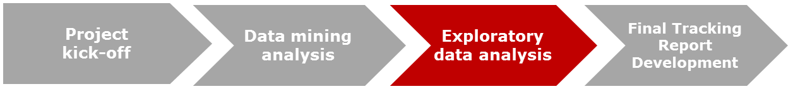
Survey data combines with data from other sources, more insights can be achieved
Detailing Strategy
Call Plan
Marketing Activity data
EDA survey
Various factors will effect physician perception in a given period. Survey data combines with other data sources can provide a more comprehensive evaluation of possible reasons for physician perception progression
Notes:
tra

Slide 19
Overview of promotion activities for physicians at different level
3. Overview of promotion activities
ILLUSTRATIVE
Average meeting count for physicians with different scores
*Other meetings including round table meeting, slide meeting, section office meeting
Average call number for physicians with different scores

Slide 20
Tracking of promotion activities for physicians at different level
3. Overview of promotion activities
ILLUSTRATIVE
Tracking of average meeting count for physicians with different scores
Select
Regional meeting/ City meeting/ Other meetings/ Other promotions
in Spotfire
Tracking of average call number for physicians with different scores
Select
Seg.1/ Seg.2/ ……/ Seg.7/Total
in Spotfire

Slide 21
Relationship of promotion activities and physician perception progression
4. Promotion activities for physician with progression
ILLUSTRATIVE
Average meeting count for physicians with progression vs. overall
+72%
+60%
+61%
Physicians with progression
+74%
Overall physicians
Regional meeting
City meeting
*Other meetings
Other promotions
Average call number for physicians with progression vs. overall
+38%
+45%
+38%
+45%
+38%
+39%
+33%
+33%
Seg.1
Seg.2
Seg.3
Seg.4
Seg.5
Seg.6
Seg.7
Total

Slide 22
Tracking of promotion activities for physicians with progression and overall
4. Promotion activities for physician with progression
ILLUSTRATIVE
Tracking of average meeting count for physicians with progression vs. overall
Select
Regional meeting/ City meeting/ Other meetings/ Other promotions
in Spotfire
Tracking of average call number for physicians with progression vs. overall
Select
Seg.1/ Seg.2/ ……/ Seg.7/Total
in Spotfire

Slide 23

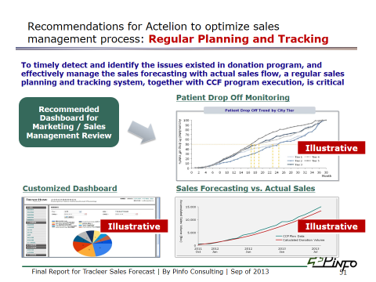
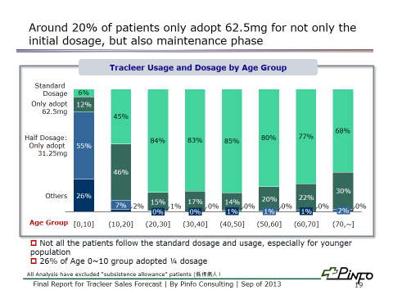
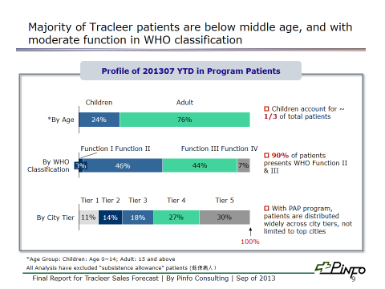
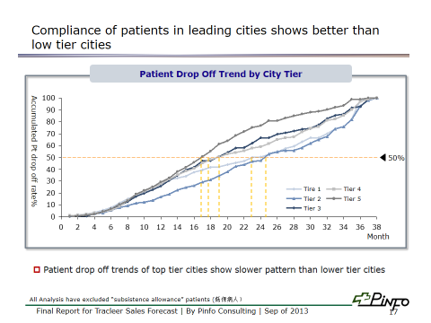
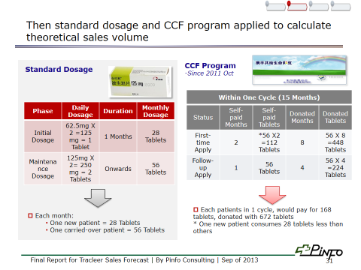
Final tracking report combining description data analysis on all data sources will be provided
Example
Notes:
tra

Slide 24
Content
Project Background
Project Objective and Approach
Timeline

Slide 25
A total of 4 weeks is needed to complete the descriptive data analysis
Week 1 | Week 2 | Week 3 | Week 4
Kick-off
Survey descriptive analysis
Descriptive analysis on other data items
Final Report and online tool Development
Final Delivery

Slide 26
Thank You!

